Slide 1
Udvikling af
Cloud-baserede
Sundheds-apps
22. November, 2023
Thomas Hildebrandt, Tilman Zuckmantel
Software, Data, People & Society
Datalogisk Institut Københavns Universitet

Slide 2
Kivy Tutorial: Your first App
A small reactive program, with input and output (Hello Thomas!)
Developed in Python, packaged so that it can be run as standalone application on MacOS, Linux, Windows, iOS, Android

Slide 3
Development in Python
Input/Output for networking
Python is an interpreted language.
Output on screen
Program source code
Interpreter
Required resources (modules, images, etc)
Keyboard input (or tap screen)
This means that if we have the source code and interpreter on our platform we can execute a Python program.

Slide 4

Development in Python– Kivy
Input/Output for networking
With Kivy we can translate a Python program into native code for a specific platform.
Output on screen
Program source code
Native application for your OS
Required resources (names of modules, images, etc)
Interpreter
Keyboard input (or tap screen)

Slide 5
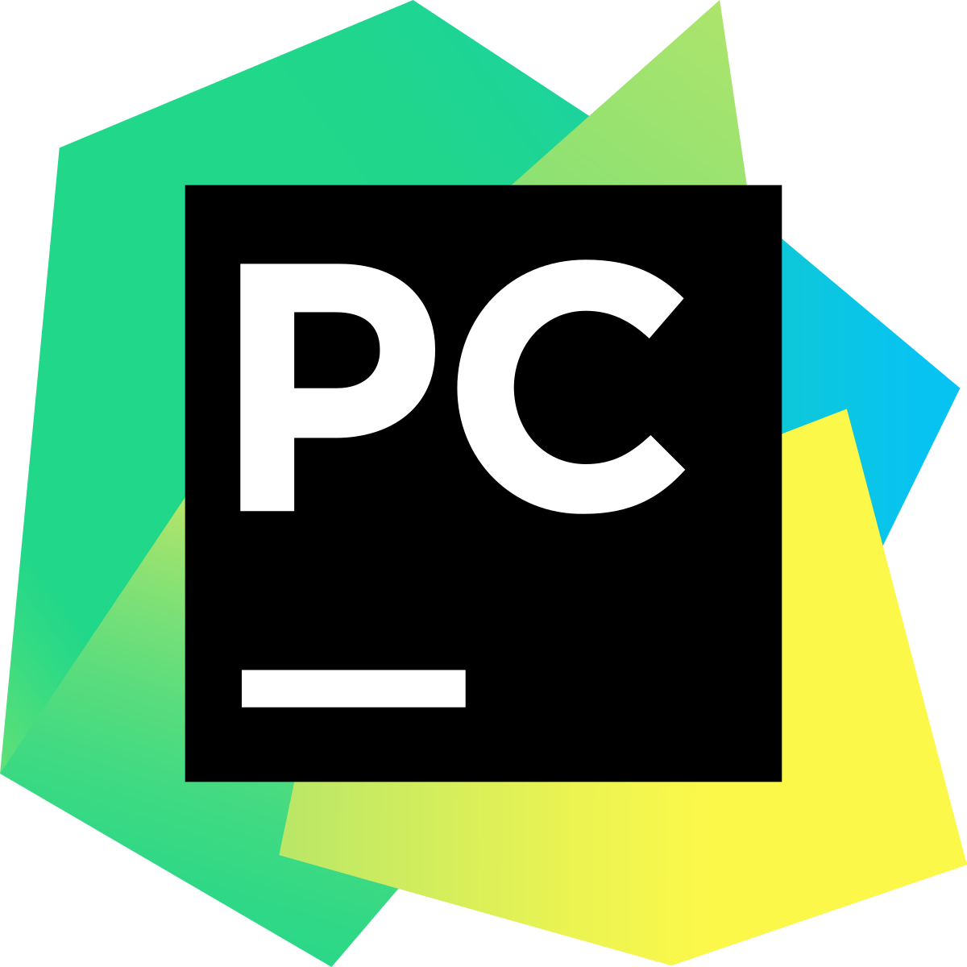
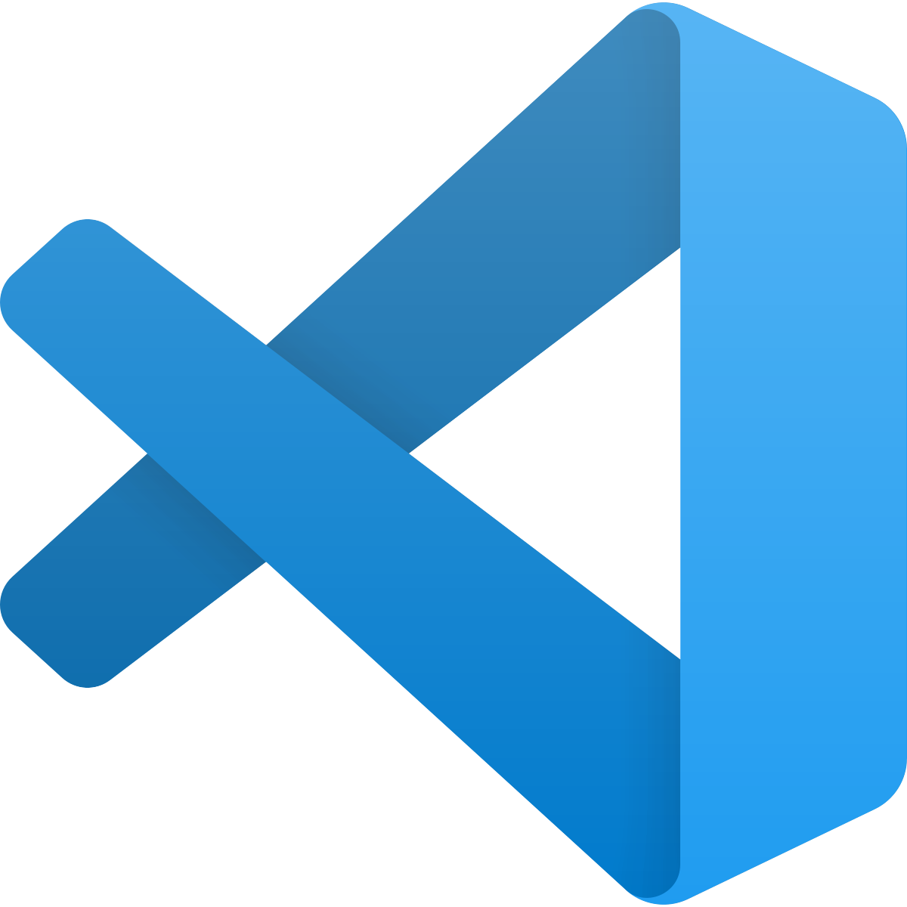
Some hints about developement
What environment should I use ?
We recommend PyCharm as a developement environment:
Importing of external modules done automatically
Sets up Kivy automatically for you
Free Ultimate access for students when login with student E-Mail address
Great help when coding
Also other environments can provide help, but some manual steps have to be performed.
Visual Studio Code

Slide 6
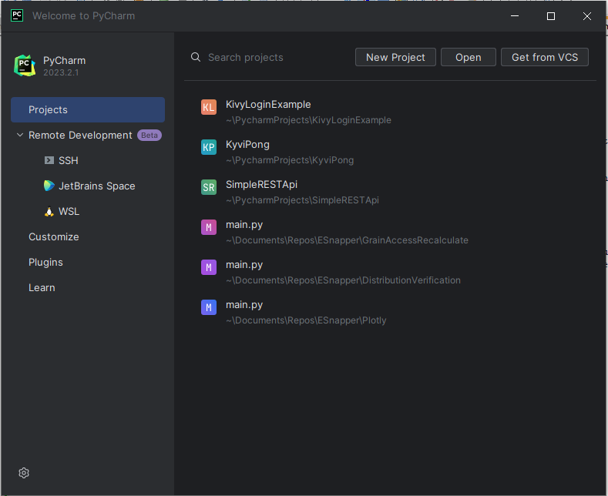
Starting a new Kivy Project

Slide 7
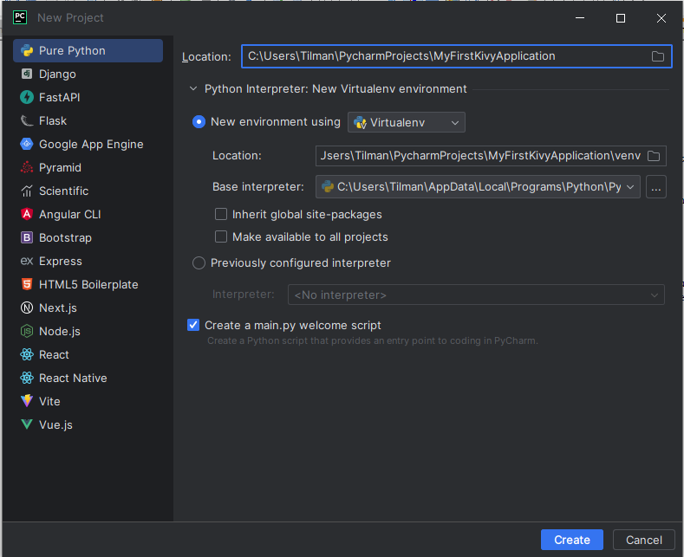
Starting a new Kivy Project
Name of the Application
Leave everything else as is
click create

Slide 8
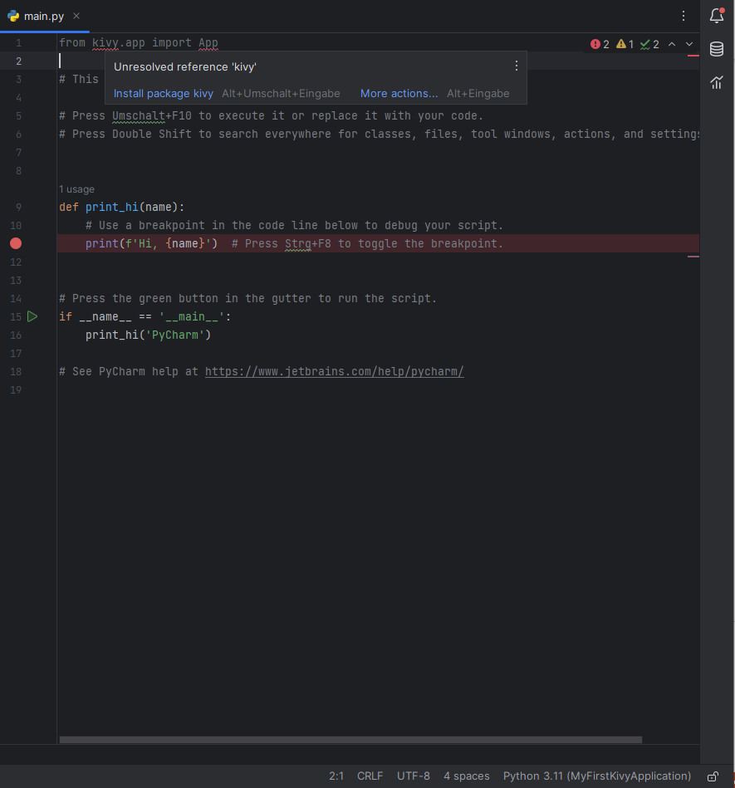
Starting a new Kivy Project
Type the import for Kivy Apps,
hover over it and click „Install package kivy“ or alternatively click Alt+Enter when hovering over kivy

Slide 9
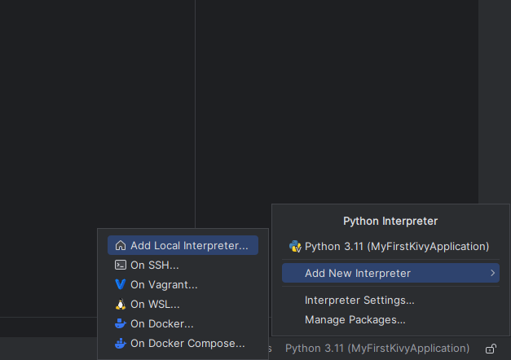
Starting a new Kivy Project
If no interpreter is that, this won‘t work
Solution: Set an interpreter first in the lower right corner of the environment

Slide 10
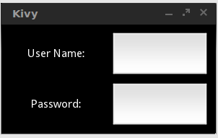
How does it work to develop a kivy app ?
Kivy uses Graphical Elements called widgets to organize a GUI
On the Top-Level we have a Widget organizing how elements are ordered
Label Widgets to display text
Text Input Widgets to write text
GridLayout 2x2
Label: User Name
Label: Password
Text Input
Text Input

Slide 11
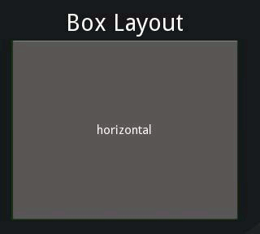
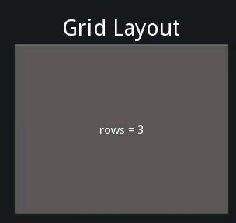
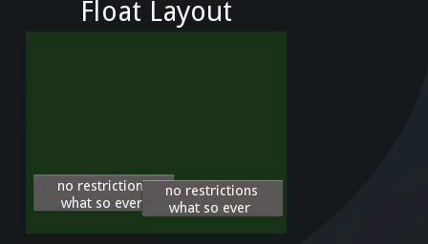
Examples of Layouts
https://kivy.org/doc/stable/guide/widgets.html

Slide 12
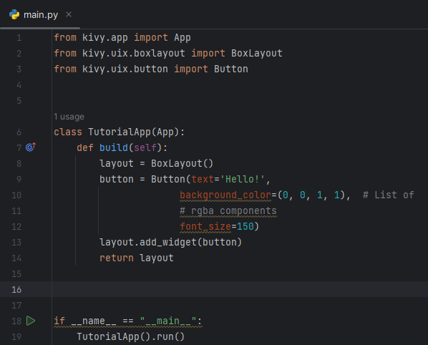
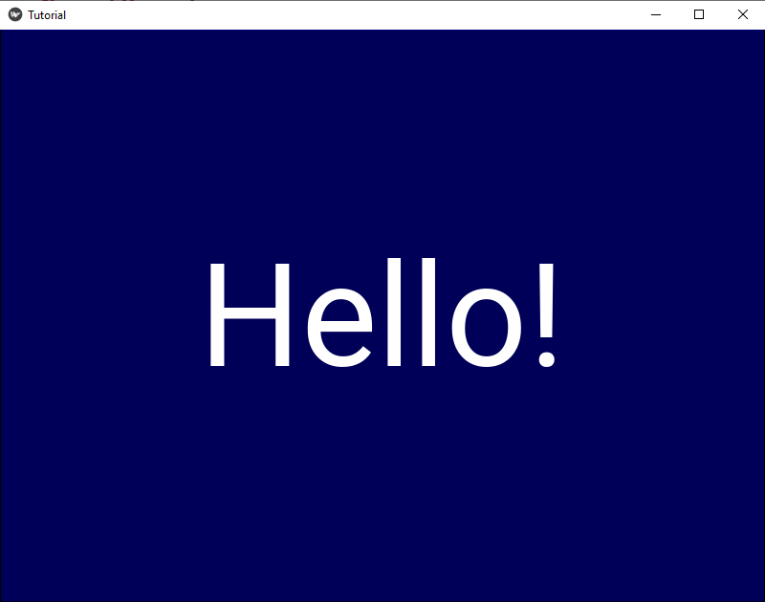
Your first Kivy App
Box Layout that positions children widgets
Button that is added as the only child widget

Slide 13
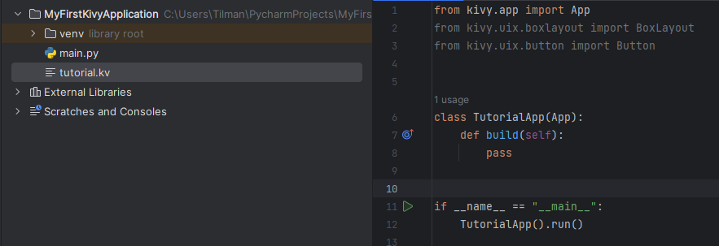
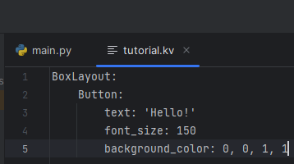
Your first Kivy App
Kivy also introduces a language to specify gui elements outside of python
Notes:
Separation of area of concern

Slide 14
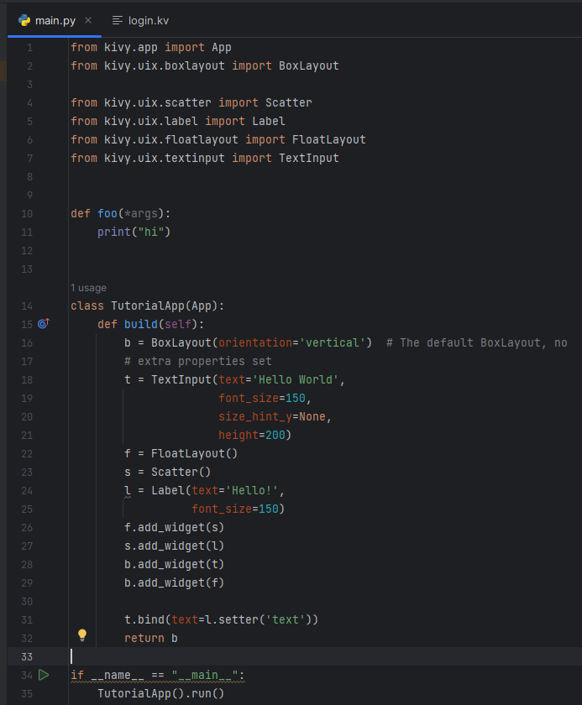
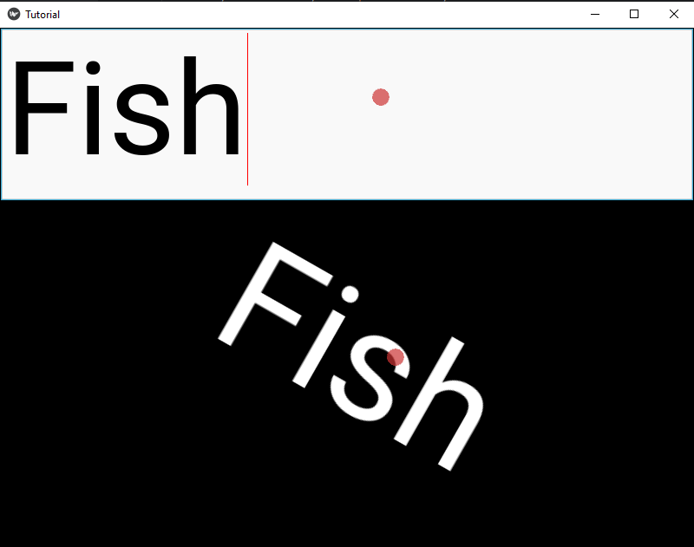
A more advanced example
This forms the top of our widget hirarchy,
ordering all children vertically
a field for text input, that shows a default text,specifying a position and font size
a layout for changing positions arbitrarily
used to make the children widgets scalable and able to rotate
the label that can be rotated
b:BoxLayout
t:TextInput
f:FloatLayout
bind text changes of t to trigger text changes of l
s:Scatter
l:Label

Slide 15
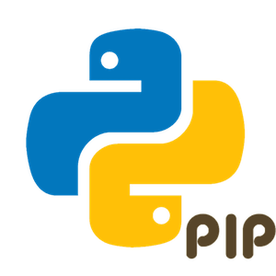
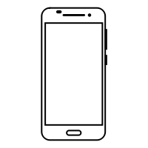
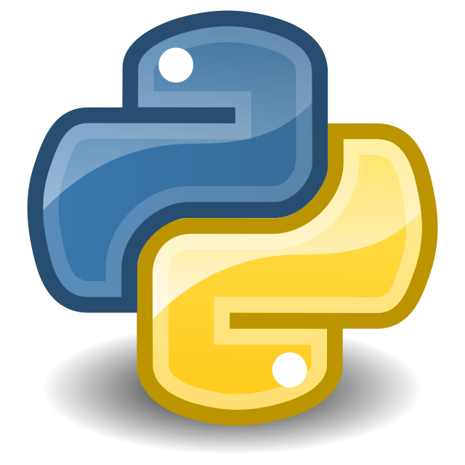


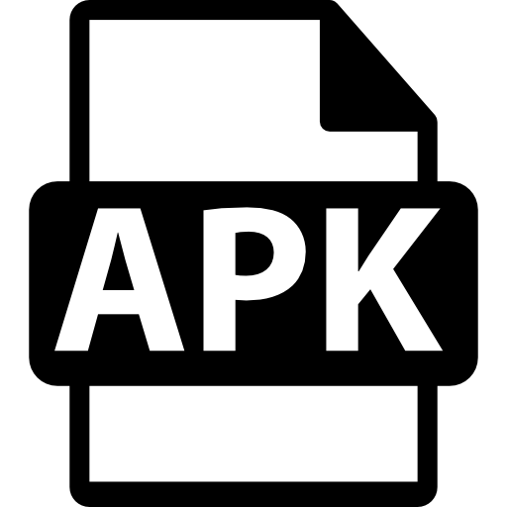
Deploying your Application for arbitrary OS Systems
- Unfortunately no uniform method, this is how it works for Android:
My Application
main.py
myGuiCode1.py
…
myGuiCodeN.py
Foo.kv
Buildozer

Slide 16
Where to find resources about Kivy ?
Documentation in Absalon
Also here: https://kivy.org/doc/stable/
Thanks for Today!

